Slide 1

Web Application Development
ជឹម ប៊ុនធឿន
Chim Bunthoeurn
Tel: 089 616173
email:chim.bunthoeurn@rupp.edu.kh

Slide 2
Content
What Web ?
What is Application ?
What is Development ?
What is Technology ?
What is IDE ?
What is Client Side Technology ?
What is Sever Side Technology?
What you must to do ?

Slide 3
Overview
Nowadays WWW is a very complex system, and it includes so many interesting new technologies.
Have you ever heard of
  Chrome, FireFox, Safari, InternetExplorer, …
  Apache, IIS, web server with Node.js
  HTML, CSS
  SSE, Ajax, XML, JSON, WebSocket
  MySQL, MongoDB
  JavaScript, PHP
  Web frameworks – Bootstrap, jQuery
  Web services
  Content management systems, …
Let’s check TRU website.
Can you find some interesting
user interactions?

Slide 4
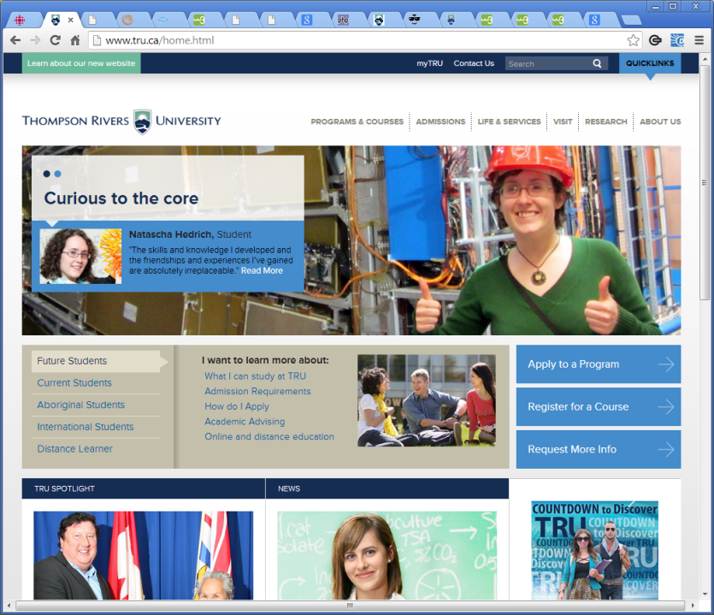
Overview
Is TRU web
  A static web page?
  An interactive web application?
    Menu, dialog boxes, user input,
    Event-driven, …
  A dynamic web application?
Menu, DB, multimedia, events, …
Can we say that the application program called TRU web is running on the client program called Chrome?
But not a standalone application

Slide 5
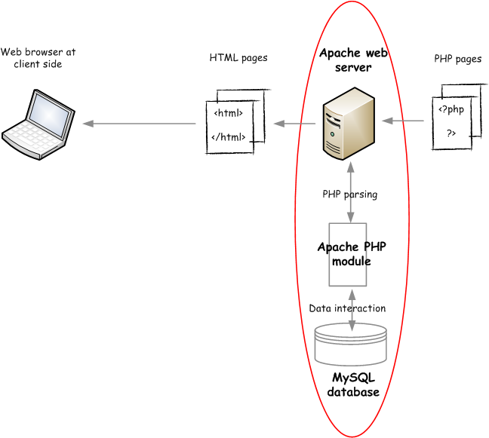

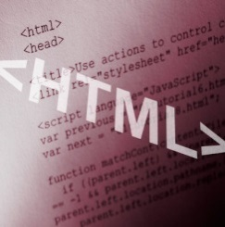


HTTP
(HTML-content,
CSS code,
JavaScript code)
HTML pages
The web application model:
  The client-server model
    Client-side web programs run on clients.
    Server-side web programs run on servers.
    HTTP between client- and server-side web programs
    Where are client-side web programs stored?
    Where are server-side web programs stored?
    For what do we need to use a server-side web program?
  How many tiers do you see in the above diagram?
    3 tier model
HTTP-URL
(*.html, *.php)
PHP pages
PHP module

Slide 6
Overview – cont.
The web application model
  Client-side web [application] programs use
    HTML – a markup language (descriptive language)
    CSS (Cascading Style Sheets) – an addition to HTML
    JavaScript – a client-side scripting [programming] language
    DOM (Document Object Model) – a model for elements in a HTML document
  Client-side web programs run on a web client called web browser, such as Chrome and FireFox.
  Server-side web programs use
    PHP – a server-side scripting [programming] language; JavaScript; …
    MySQL – a database system; MongoDB; …
  Server-side web programs run on a web server, such as Apache and Node.js.
  Client- and server-side web programs can exchange information in the form of XML (???) and JSON (???) using HTTP (???).

Slide 7
Overview – cont.
Client-side web programs are written in HTML, CSS, and JavaScript.
  HTML and CSS display elements in a web document(/page/program) on a window. -> static programs
  All HTML elements are modeled by DOM.
  JavaScript controls and changes the elements through DOM so that the users can see the change on the window. -> interactive programs
  JavaScript is also used to exchange information with a server-side web program.
Server-side web programs are written in PHP, JavaScript(, HTML, CSS, JavaScript), ….
  They are usually used to access databases.
  They generate web content(, i.e., client web programs,) that will be sent back to the client. -> dynamic programs
  They are also used to exchange information with a client-side web program.
JavaScript and PHP are complete programming languages.
A whole new programming paradigm.

Slide 8
Overview – cont.
Client-side programs |  |  |  |  | Server-side scripts |  | SQL, NoSQL
HTML CSS Bootstrap | DOM <---> |  | JavaScript jQuery … |  | PHP JavaScript … |  | MySQL MongoDB …
User interface |  | Processing Logic |  |  | Processing Logic |  | Processing
Web client: Chrome FireFox … |  |  |  |  | Web server: Apache Node.js … |  | DB server: MySQL …

Slide 9
Overview – cont.
Summary
Client |  | Server |  | Communication | Other
HTML5 CSS3 (user interface) | JavaScript DOM (processing) | PHP | MySQL | Polling, SSE iframe AJAX JSON, XML | Security Cookies, sessions
Static web pages <------------------>
Interactive web applications <----------(COMP 2680)---------->
Bootstrap jQuery Dynamic web applications <------------------------------------------------------------------->
Rich dynamic web applications <--------------------------------------------------(COMP 3540)---------------------------------------------------->
Bootstrap | jQuery AngularJS T3PO … | Node.js … | MongoDB | WebSocket WebRTC … | Web services Frameworks Mining HTML5 APIs…
Web-based information systems <---------------------------------------------------(COMP 4620)--------------------------------------------------->

Slide 10
Overview – cont.
Application architecture
  In which side do we need to support user interface and data processing?
  Only server side?
    Model View Control (MVC)
  Client side as much as possible?
    Single Page Applications (SPA)

